Slide 1
SOLID Principles of OOD
Chris Gibson
Sameeri Marryboyina

Slide 2


Slide 3
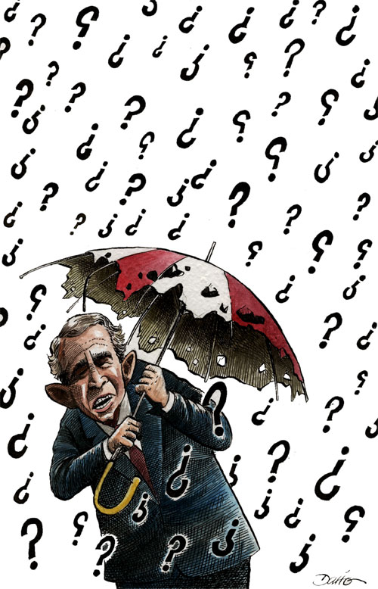


Slide 4
EPP Motivation

Slide 5
Engineering Philosophy
Beautiful, Maintainable Code
We want to “Care” about our code

Slide 6
Norman Rockstars follow
Kaizen
Yesterday we have code that works
Today we want to improve it

Slide 7
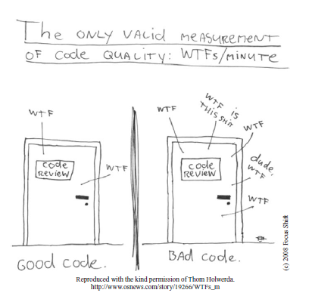
Clean Code

Slide 8
SOLID Design Principles

Slide 9

The One CONSTANT in Software development

Slide 10
How does our software respond to CHANGE?

Slide 11
Code Smells
Refactoring – Improving the design of existing code [Martin Fowler]
Clean Code : A handbook of Agile Software Craftsmanship [Bob Martin]
Catalog of smells

Slide 12
Design Smells
Rigidity
Fragility
Viscosity
Immobility

Slide 13
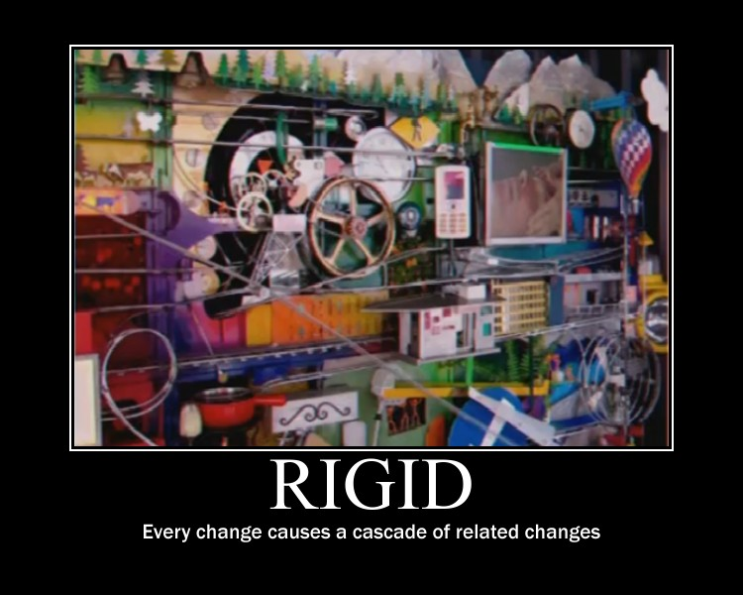

Slide 14
RIGIDITY
Rigidity is the tendency for software to be difficult to change, even in simple ways. A design is rigid if a single change causes a cascade of subsequent changes in dependent modules. The more modules that must be changed, the more rigid the design.

Slide 15
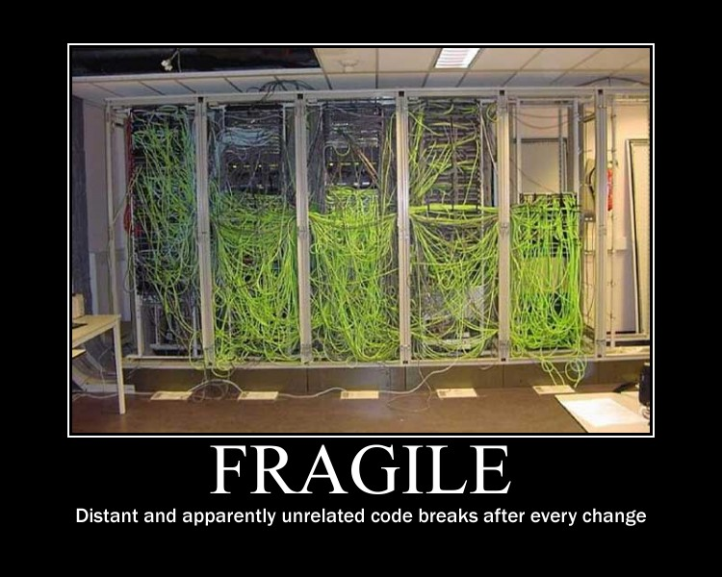

Slide 16
Fragility
Fragility is the tendency of a program to break in many places when a single change is made. Often, the new problems are in areas that have no conceptual relationship with the area that was changed. Fixing those problems leads to even more problems, and the development team begins to resemble a dog chasing its tail.

Slide 17
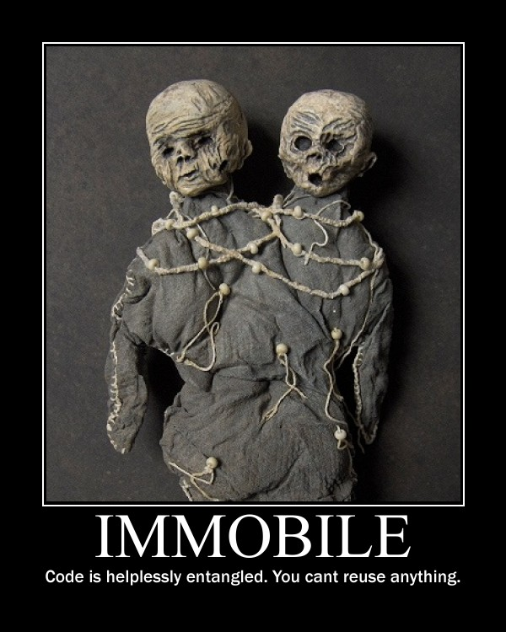

Slide 18
IMMOBILITY
A design is immobile when it contains parts that could be useful in other systems, but the effort and risk involved with separating those parts from the original system are too great. This is an unfortunate but very common occurrence.

Slide 19
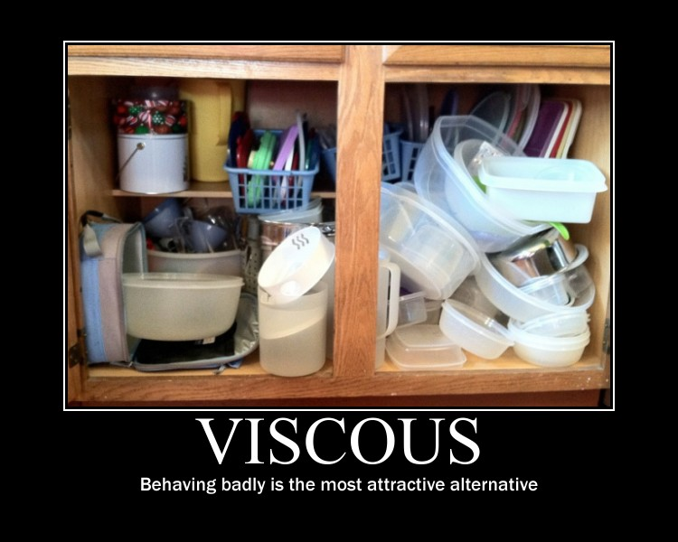

Slide 20
VISCOSITY
A viscous project is one in which the design of the software is difficult to preserve. Friction develops and slows us down. We want to create systems and project environments that make it easy to preserve and improve the
design.

Slide 21
Other OO Developers
Have committed the same mistakes
Have learnt from those mistakes
Have specified some GUIDELINES
We can choose to follow or not!
If we choose to follow, we have to understand the problems and where they apply.
If we encounter the same issues, we can meditate on these guidelines and apply them.

Slide 22
So, what are SOLID principles about?
Better question would be : What problems are they trying to solve?
They are trying to solve a specific set of problems, namely

Slide 23
DEPENDENCY MANAGEMENT ISSUES

Slide 24
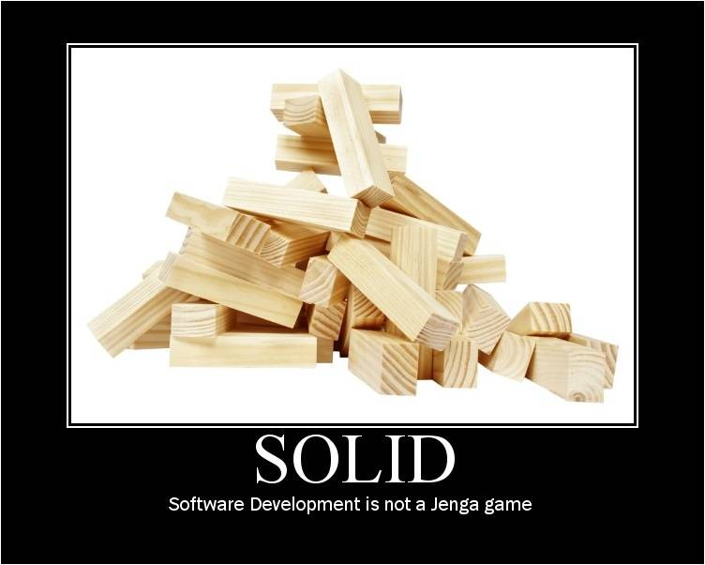

Slide 25
SOLID principles of Object Oriented Design
Single Responsibility Principle
Open/Closed Principle
Liskov Substitution Principle
Interface Segregation Principle
Dependency Inversion Principle

Slide 26
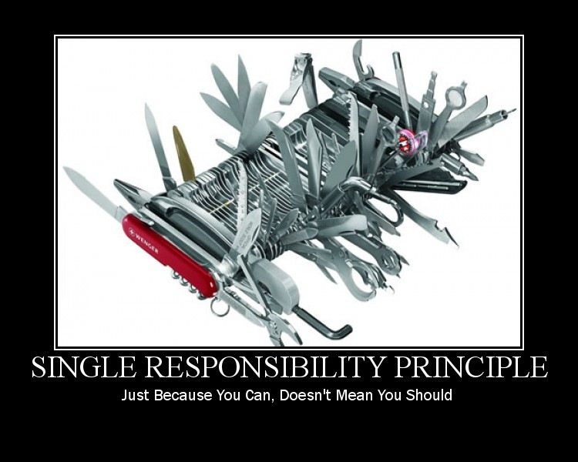

Slide 27
Talk is cheap, show me the code - Linus Torvalds

Slide 28
Reflect on SRP

Slide 29
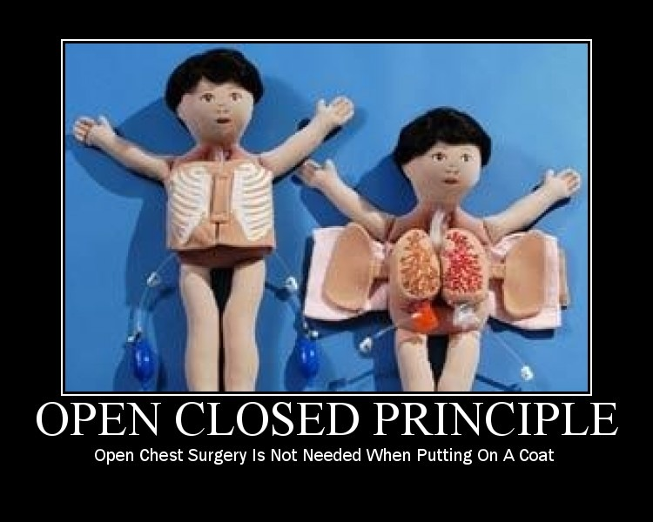

Slide 30
Reflect on OCP

Slide 31
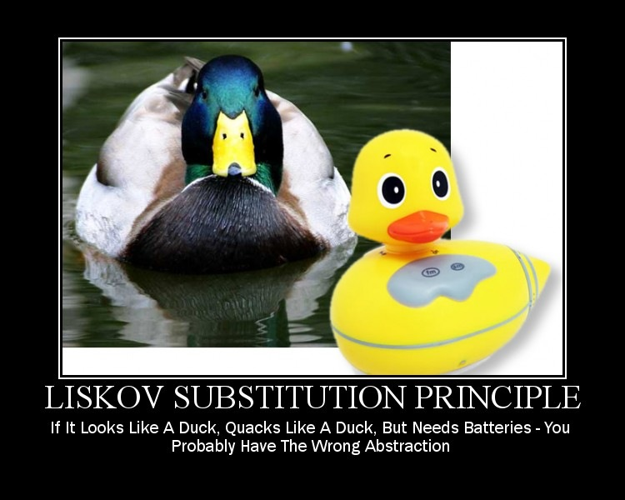

Slide 32
Reflect on LSP

Slide 33
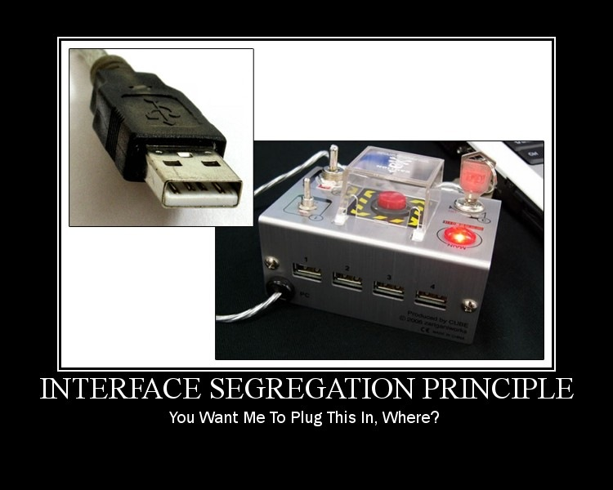

Slide 34
Reflect on ISP

Slide 35
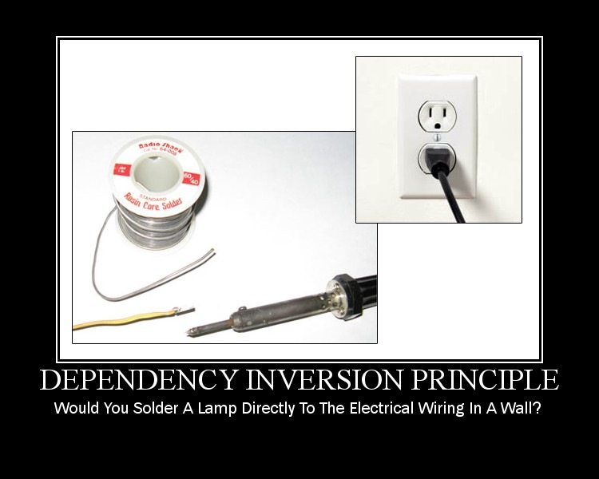

Slide 36
Reflect on DIP

Slide 37
Other design smells & principles
Needless Repetition : DRY
Complex/Over design : YAGNI, KISS

Slide 38
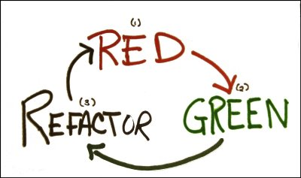
When to apply SOLID Design Principles
TDD presents us an opportunity

Slide 39
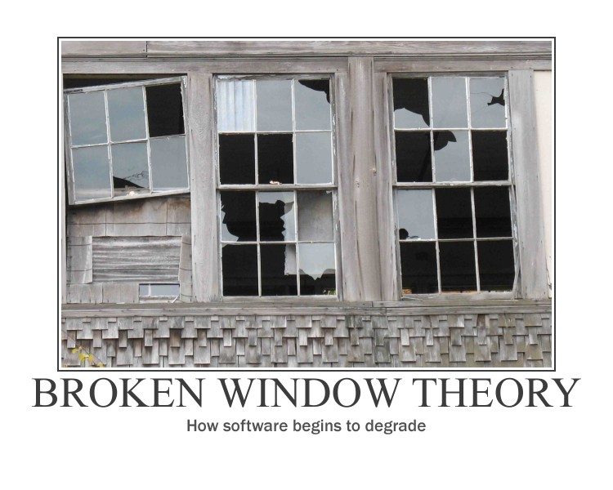

Slide 40


Slide 41
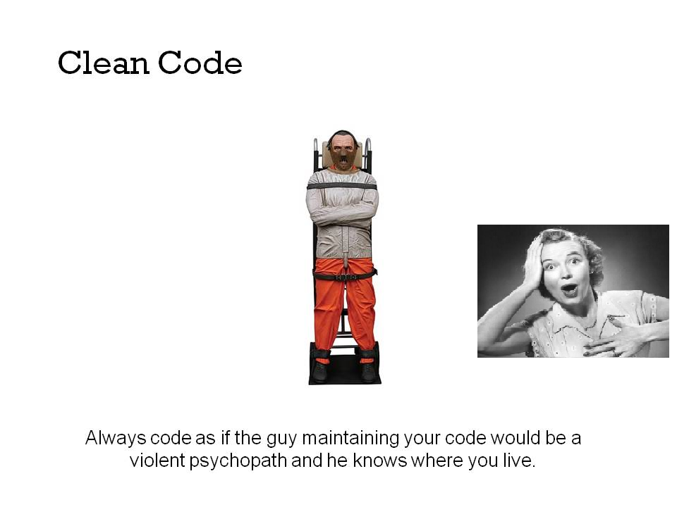

Slide 42
What Next?

Slide 43

Mediate on these principles

Slide 44
For us, its constant learning
Design Patterns
Refactoring to Patterns
Architectural Patterns
Patterns in JavaScript

Slide 45
References

